Slide 1
Adapter Design pattern
Presented by:
Ikram Asmat-142_4C
Zain Ali Abid-157_4C

Slide 2
Content
What is Adapter and where it is used?
Intent
Example
Pros And Cons
Applicability
Types
Participants
Conclusion

Slide 3
What is adapter?
The Adaptor Pattern convert the interface of a class into another interface that clients expect.
Adaptor lets classes work together that couldn’t because of incompatible interfaces.
Uses
In software Engineering , the Adaptor pattern is used to allow the interface of an existing class to be used as another interface.
It is often used to make existing classes work with others without modifying their source code.

Slide 4
Real life examples
Consider that you have some pictures in your memory card and you need to transfer them to your computer. In order to transfer them you need some kind of Adaptor that is compatible with computer ports so that you can attach memory card to your computer.
In this case card reader is an Adaptor.
Another example would be a translator translating words spoken by one person to another.

Slide 5
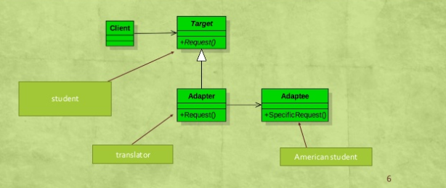
Another example with implementation through class diagram

Slide 6
Class Adaptor pattern
PROS
Only one new object , no additional indirections.
Less code required than the object Adaptor.
Can override adoptee’s behavior as required.
CONS
Requires Sub-classing(tough for single inheritance)
Less Flexible than object Adaptor.

Slide 7
Object Adaptor pattern
PROS
More flexible than class Adaptor.
Doesn’t require sub-classing to work.
Adaptor works with adoptee and all of its sub-classes.
CONS
Harder to override adoptee’s behavior.
Requires more code to implements properly.

Slide 8
applicability
Use an existing class whose interface does not match the requirements.
Create a re-useable class through the interfaces are not necessarily compatible with the callers.
Want to use several existing sub-classes , but it is impractical to sub-class everyone
(Object Adaptor only)

Slide 9
Types of Adaptor
There are two types of Adaptor
Class Adaptor
Object Adaptor

Slide 10
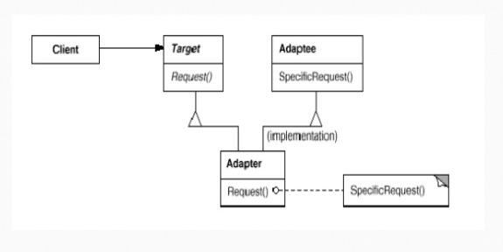
Structure of Class Adaptor

Slide 11
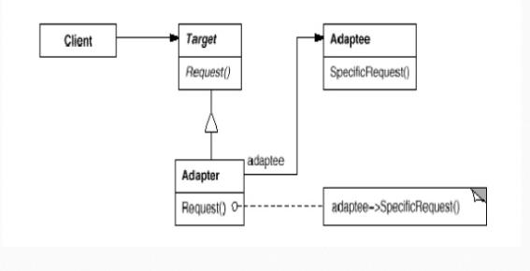
Structure of object Adaptor

Slide 12
Participants
Target(Shape)
Define the domain-specific interface that client uses.
Client(Drawing Editor)
Collaborates with objects conforming to the target interface.
Adoptee(Text View)
Defines an existing interface that needs adopting.
Adaptor(Text Shape)
Adopts the interface of adoptee to the target interface.

Slide 13
Conclusion
Allows collaboration between classes with incompatible interfaces.
Implemented in either classes based(Inheritance) or object based (composition and delegation) manner.
Useful pattern which promotes reuse and allows integration of diverse software components.

